Slide 1
Computer System Architecture Assignment 01
Higher Nationals Diploma in Computing & Subsystems Development
Shenesh Perera

Slide 2
Why an Operating System?
Operating systems are the interface between the computer system and the user, this particular system software is what allows a user to give instructions to a system in real-time.
An operating system is vital as it makes proper use of the resources, ensures security and maintains a attractive GUI for a user to interact with a system.
Operating Systems can be categorized on different factors, but for this package, we will categorize them using their architecture
There are Layered, Monolithic, Micro-kernel and Distributed Operating Systems.

Slide 3
Functions of an Operating System
Device Management
Memory Management
Process Management
File Management
Security & Error Management

Slide 4
Device Management
Devices are the raw hardware that allows the computer system to perform tasks efficiently.
They typically contain, data, software and sensors and/or actuators to enable the IT environment to interact with the external environment.
These Devices having varying degrees of connectivity, intelligence and security that need to be factored into the set of architectural choices that are adopted. Device management is essential and is required to perform many device management tasks:
Provisioning includes initialization and activation of devices
Configuration includes establishment of setting and parameters for device operation.
Software upgrade are required to improve device operating mode, performance and potentially security.
Fault management is required to deal with error reporting and device status updates. This area also includes capability to deal with device faults and extraordinary behaviors.

Slide 5
Memory Management
Memory management is the process of controlling and coordinating computer memory, assigning portions called blocks to various running programs to optimize overall system performance.
Memory management resides in hardware, in the OS and in programs and applications.
In hardware, memory management involves components that physically store data, such as RAM. In the OS, memory management involves the allocation of specific memory blocks to individual programs as user demands change.
At the application level, memory management ensures the availability of adequate memory for the objects and data structures of each running program at all times. Application memory management combines two related tasks, known as allocation and recycling.

Slide 6
Process Management
Process management is an integral part of any modern day operating system.
The OS must allocate resources to processes, enable processes to share and exchange information, protect the resources of each process from other processes and enable synchronization among processes.
Processes should be organized in such a way individual process are privately carried out and they obtain ONLY the designated amount of resources.
This ensures the status of the process, making the decision to store in between input and output cycles and maximum efficiency in terms of energy consumption to work done.

Slide 7
File Management
File management ensures that directories, and sub-directories File management system is NOT the same as a file system. In Windows, Windows Explorer does all of this.
A file management system is also known as a file manager.
In a computer system, a file system is the way in which files are named and where they are placed logically for storage and retrieval.
File systems specify conventions for naming files, including the maximum number of characters in a name, which characters can be used and, in some systems, how long the file name suffix can be.
A file system also includes a format for specifying the path to a file through the structure of directories.

Slide 8
Security & Error Management
The OS of a computer has a number of built-in tools to protect against security threats, including the use of virus scanning utilities and setting up a firewall to block suspicious network activity.
One of the most common ways to get a computer virus is by e-mail. If you have received an e-mail message from someone you don't know with an unknown file attachment, be careful about opening up that file since it may just contain a virus or other malicious software.

Slide 9
Most of the time, data loss occurs due to errors, as such error management is VERY critical for a system. This is a broad term which in engineering jargon can designate two very different things:
A hardware, software or human issue requiring attention, which breaks the normal flow of computer programs.
A kind of user mistake where software does what a user ask for, but not what the user meant.
Contrary to widespread belief among computer system engineers, although computer hardware is not without its quirks, it is overall pretty reliable. After all, trillions of times a day, typical computer hardware correctly and quickly performs its designated tasks over and over again.
This is where the Operating System falls into, to ensure that the hardware does what it should and with as less errors as possible.

Slide 10
The evolution of Operating Systems
Distributed Operating Systems
DRDOS
PCDOS
Microsoft DOS
Windows XP
Windows 7
Windows 8/8.1
Windows 10
Unix
Minix
Linux +GNU
Redhat
Debian
Mandriva
Ubuntu Kiwi
MacOS
Solaris
BSD
Android
Fedora
Figure 1.0

Slide 11
The crucial features of an OS
Performance- An OS must be capable of providing high-tier performance when used for the purpose it was produced for.
Security-An OS must ensure all it’s data is safe.
Ease of Use-An OS must provide an interface in such a way the user who uses it receives the expected experience.
Portability-An OS must always have a good compatibility with multiple computer systems.

Slide 12
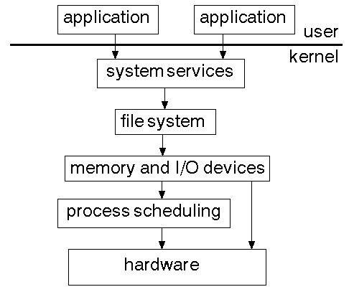
Layered OS
Each factor of the OS is divided into layers that are independent.
Higher level layers will request services from lower level layers which means low level layers respond to requests.
The application level can interact with the kernel through a shell.
Figure 1.1 2016/07/29, techgeeks.com, Mr. Amos

Slide 13
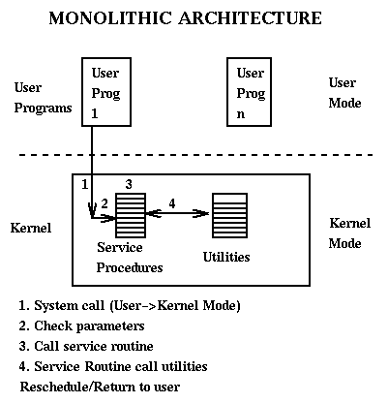
Monolithic OS
This type of OS will mimic the concept of a layered OS but all data & code will be in the same layer.
The user mode & the kernel mode of the Monolithic OS is on the same layer.
The security in this OS is very low, therefore is very easy to implement.
Figure 1.2 2014/02/12, techopedia, team of the techopedia

Slide 14
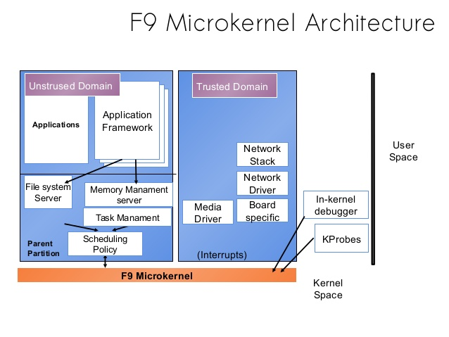
Micro-kernel OS
This OS has very high security as the same layered structure is obeyed but the application level can not directly interact with the kernel.
There is a micro-kernel outside the kernel that the application level must first interact with.
All application based tasks are handled in the micro-kernel level.
Minix for example follows a layered micro-kernel architecture.
Figure 1.3 2013/05/11, geeksforgeeks.com

Slide 15
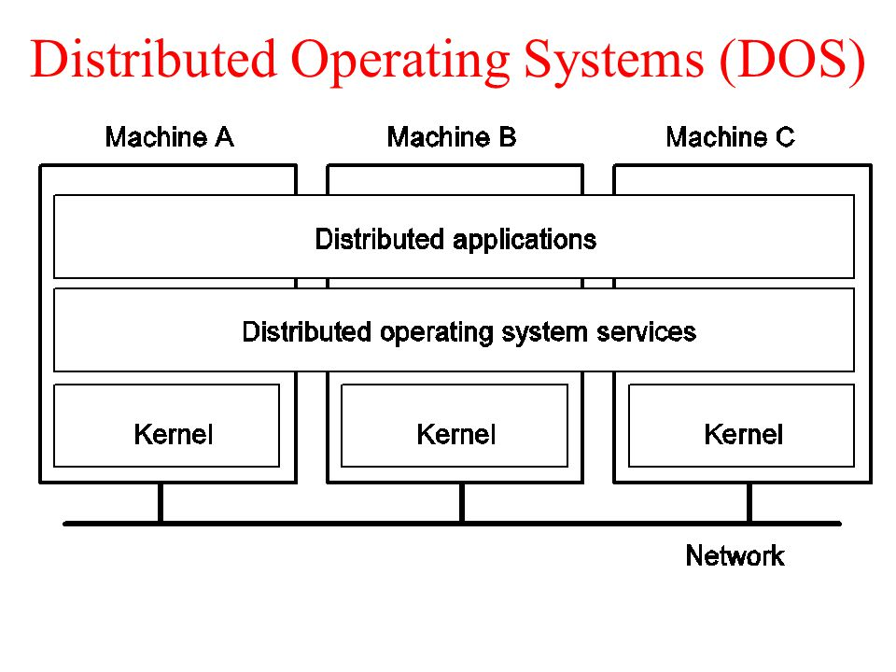
Distributed OS
DOS is capable of independently serve multiple users from the same system.
DOS handles tasks using multiple CPUs, each particular They handle jobs which are serviced by multiple CPUs.
Each process is serviced by 2 sets of distinct provision services.
One of them is what provides a kernel interface to the hardware, the other is a set of system maintaining software that lead each processes’ activities.
Figure 1.4, itexplanation.com, 2016/07/20

Slide 16
Usage Environments
Each OS has a specific usage environment they are entitled to. A developer may find windows limiting but Ubuntu a fascinating habitat to do all his/hers work on.
Not only do specifications matter when installing an OS but the previous experience, knowledge, capacity and potential of an individual does too.
Microsoft DOS operating systems are perfect for IT labs where the major requirement is to fulfill daily tasks, installing a GNU/Linux based OS as the only OS is a foolhardy decision as performing daily tasks becomes very difficult for such OSes.
Ex: Microsoft Office doesn’t support most GNU/Linux based systems.

Slide 17
Therefore in an IT lab, it is ideal if the majority of the systems are composed of Microsoft DOS systems like Windows 8/8.1 or 10.
If development, scalability and productivity in terms of interacting with implicit functions of a system is your need, then either;
Installing said Linux/GNU OS as the secondary OS
B) Install it in a Virtual Environment.
In the end of the day, it all depends on the demand the employees in an IT lab desire. All in all, my preference would Microsoft DOS systems for day-to-day procedures and Linux/GNU systems as a secondary OS to dual boot for specific tasks.

